Slide 1

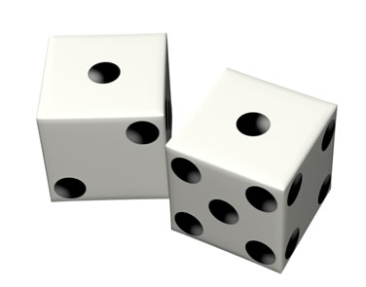
Pseudorandom Generators for Combinatorial Shapes
Parikshit Gopalan, MSR SVC
Raghu Meka, UT Austin
Omer Reingold, MSR SVC
David Zuckerman, UT Austin

Slide 2


Is RL = L?
PRGs for Small Space?
Saks-Zhou:
Nis 90, INW94: PRGs for polynomial width ROBP’s with seed .
Can do O(log n) for these!
Poly. width ROBPs.
Nis-INW best.
Combinatorial shapes: unifies and generalizes all.
Comb. Rectangles
0/1 Halfspaces
Small-Bias
Modular Sums

Slide 3
What are Combinatorial Shapes?

Slide 4

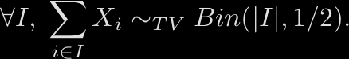

Fooling Linear Forms
For
Question: Can we have this “pseudorandomly”?
Generate ,

Slide 5

Why Fool Linear Forms?
Special case: small-bias spaces
Symmetric functions on subsets.
Question: Generate ,
Previous best: Nisan90, INW94.
Been difficult to beat Nisan-INW barrier for natural cases.

Slide 6
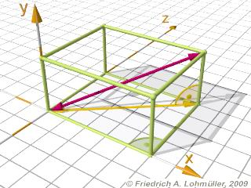
Combinatorial Rectangles
What about
Applications: Volume estimation, integration.

Slide 7
Combinatorial Shapes

Slide 8
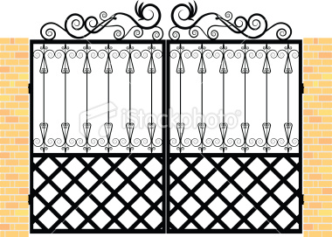

Combinatorial Shapes

Slide 9
PRGs for Combinatorial Shapes
Unifies and generalizes
Combinatorial rectangles – sym. function h is AND
Small-bias spaces – m = 2, h is parity
0-1 halfspaces – m = 2, h is shifted majority

Slide 10

Previous Results
Our Results
Reference | Function Class | Seed Length
Nis90, INW94 | All Shapes
LLSZ92 | Comb. Rects, Hitting sets
EGL+92, ASWZ96, Lu02 | Comb. Rectangles
NN93, LRTV09, MZ09 | Modular Sums
M., Zuckerman 10 | Halfspaces
Thm: PRG for (m,n)-Comb. shapes with seed .

Slide 11

Discrete Central Limit Theorem
Sum of ind. random variables ~ Gaussian
Thm:

Slide 12

Discrete Central Limit Theorem
Close in stat. distance to binomial distribution
Thm:
Optimal error: .
Proof analytical - Stein’s method (Barbour-Xia98).

Slide 13
This Talk
1. PRGs for Cshapes with m = 2.
Illustrates main ideas for general case.
2. PRG for general Cshapes.
3. Proof of discrete central limit theorem.

Slide 14
Fooling Cshapes for m = 2
~ Fooling 0/1 linear forms in TV.
Question: Generate ,

Slide 15



Fooling Linear Forms in TV
Thm MZ10: PRG for halfspaces with seed
1. Fool linear forms with small test sizes.
Bounded independence, hashing.
2. Fool 0-1 linear forms in cdf distance.
PRG for halfspaces: M., Zuckerman
3. PRG on n/2 vars + PRG fooling in cdf
PRG for linear forms, large test sets.
Question: Generate ,
3. Convolution Lem: close in cdf to close in TV.
Analysis of recursion
Elementary proof of discrete CLT.

Slide 16
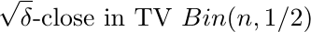
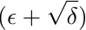
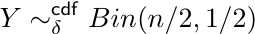
Recursion Step for 0-1 Linear Forms
For intuition consider
X1
…
Xn/2
Xn/2+1
…
Xn
PRG -fool in TV
PRG -fool in CDF
True randomness
PRG -fool in TV
PRG -fool in TV

Slide 17
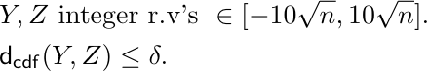

Recursion Step: Convolution Lemma
Lem:

Slide 18
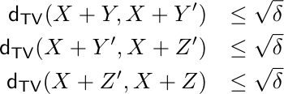
Convolution Lemma
Problem: Y could be even, Z odd.
Define Y’:
Approach:
Lem:

Slide 20
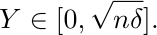
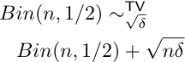
Convexity of : Enough to study

Slide 21
Recursion for General Case
Problem: Test set skewed to first half.
Solution: Do the partitioning randomly.
Test set splits evenly to each half.
Can’t use new bits for every step.

Slide 22
Recursion for General Case
X1
X2
X3
…
Xn
Geometric dec. blocks via Pairwise Permutations
…
Xj
…
X1
Xi
…
Truly random
MZ on n/4 Vars
MZ on n/2 Vars
Fool 0-1 Linear forms in TV with seed
Analysis: Induction. Balance out test set.
Final Touch: Use Nisan-INW across recursions.

Slide 23
This Talk
1. PRGs for Cshapes with m = 2.
Illustrates main ideas for general case.
2. PRG for general Cshapes.
3. Proof of discrete central limit theorem.

Slide 24


From Shapes to Sums

Slide 25
From m = 2 to General m
Test set Large vs Small
For large: true ~ binomial
For small: k-wise
High or Low Variance
Var. high: shift-invariance
For small: k-wise

Slide 26
PRGs for CShapes
1. PRG fooling low variance CSums.
Sandwiching poly., bounded independence.
2. PRG fooling high var. CSums in cdf.
Same generator, similar analysis.
3. PRG on n/2 vars + PRG fooling in cdf
PRG for high variance CSums
3. Convolution Lemma.
Work with shift invariance.
Balance out variances (ala test set sizes).

Slide 27
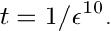
Low Variance Combinatorial Sums
Need to look at the generator for halfspaces.
Some notation:
Pairwise-indep. hash family
k-wise independent generator
We use

Slide 28
Core Generator
x2
x2
x2
x3
x3
x4
x4
x4
x5
x5
x1
x5
…
x1
…
xk
…
xk
…
xn
xn
xn
xn
1
2
t
2
t
INW on top to choose z’s.
Randomness:

Slide 29
Low Variance Combinatorial Sums
Why easy for m = 2? Low var. ~ small test set
Test set well spread out: no bucket more than O(1).
O(1)-independence suffices.
x1
x2
x3
x5
xk
xn
x3
x4
x5
…
xk
…
1
2
t

Slide 30
Low Variance Combinatorial Sums
For general m: can have small biases.
Each coordinate has non-zero but small bias.
x1
x2
x3
x4
x5
…
xk
…
xn
1
2
t

Slide 31
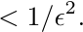
Low Variance Combinatorial Sums
Total variance
Variance in each bucket !
Let’s exploit that.
x1
x2
x3
x4
x5
…
xk
…
xn
1
2
t

Slide 32
Low Variance Combinatorial Sums
Use 22-wise independence in each bucket.
Union bound across buckets.
Proof of lemma: sandwiching polynomials.

Slide 33
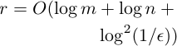
Summary of PRG for CSums
1. PRGs for low-var CSums
Bounded independence, hashing
Sandwiching polynomials
2. PRGs for high-var CSums in cdf
PRG for halfspaces
3. PRG on n/2 vars + PRG in cdf
PRG for high-var CSums.
PRG for CSums

Slide 34
This Talk
1. PRGs for Cshapes with m = 2.
Illustrates main ideas for general case.
2. PRG for general Cshapes.
3. Proof of discrete central limit theorem.

Slide 35
Discrete Central Limit Theorem
Close in stat. distance to binomial distribution
Thm:

Slide 36
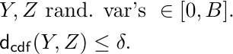
Convolution Lemma
Lem:

Slide 37
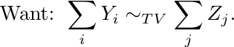
Discrete Central Limit Theorem
Same mean, variance
All four approx.
same means, variances

Slide 38
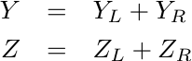
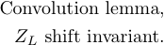
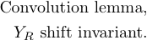
Discrete Central Limit Theorem
By CLT: small.
By unimodality: shift invariant.
All parts have similar
means and variances
Hence proved!
General integer valued case similar.

Slide 39
Open Problems
Optimal dependence on error rate?
Non-explicit:
Solve for halfspaces
More general/better notions of symmetry?
Capture “order oblivious” small space.
Better PRGs for Small Space?

Slide 40
Thank You

